Slide 1
Student Induction Program (and this FDP)
Model Curriculum for Undergraduate Degree Courses in Engineering and Technology
January 2018

Slide 2
Background
In its 49th meeting of the Council held on 14th March 2017, approved a package of measures for further improving the quality of technical education in the country.
This is articulated in the AICTE Model Curriculum.
The 3-week Student Induction Program (SIP) is one of the mandatory programs.
AICTE formed a National Coordination Committee for SIP (NCC-IP) to prepare teachers in the ratio of 1:20 (1 teacher per 20 students). Teachers from every teaching department are expected.
This FDP is organised by the NCC-IP
for the preparation of facilitators and mentors
of the UHV-I module of SIP.
There are other FDPs for the other modules of SIP
For details of SIP, please see video of Chairman NCC-IP

Slide 3
Purpose of this 3-Day FDP-SI
This 3-day FDP-SI is intended as the orientational input to for preparing you as a facilitator for the UHV-I module of the SIP.
The basic minimum preparation required to be a UHV-I facilitator is to:
Successfully complete the 7/8-day FDP-SI on UHV
Continue your self-study and the process of self-exploration
Please note that this FDP is not intended to prepare you as the coordinator of the SIP. However, it can be of immense value to SIP Coordinators as well, in terms of providing the underlying vision for human education for the development of the full potential of human being and a humane society, which is just and equitable.
The SIP is to be coordinated by the Dean Student Affairs or Dean Academic Affairs or some other suitable authority at your institution.

Slide 4
Students’ Induction Program – Goals
Becoming familiar with the ethos and culture of the institution (based on institutional culture and practices)
Exposure to a holistic vision of life (based on larger national and human good; or the well-being of all)
Learning a creative skill in arts to express the larger vision of life (learn one art form like painting or music)
Healthy lifestyle and ethical professional discipline (e.g. getting up early, sleeping on time, contributing to the subject of study)
Overcoming weaknesses in some essential professional skills – only for those who need it (e.g. Mathematics, Language proficiency modules)

Slide 5
Students’ Induction Program – Modules
1 Universal Human Values (UHV-I)
2 Physical Health and Related Activities
3 Creative Arts and Culture
4 Literary Activities
5 Proficiency Modules
6 Lectures by Eminent People
7 Visits to Local Areas
8 Familiarisation to institution, Department/Branch and Innovations
and Extra-Curricular Activities in College

Slide 6
1 Universal Human Values (UHV-I)
Objectives:
To help the student to see the need for developing a holistic perspective of life
To sensitise the student about the scope of life – individual, family (inter-personal relationship), society and nature/existence
Strengthening self-reflection
To develop more confidence and commitment to understand, learn and act accordingly
Methodology:
A self-reflective methodology of teaching is adopted. It facilitates understanding through self-exploration. The dialogue starts between the faculty and the student
It opens the space for the student to explore his/her role (value) in all aspects of living – as an individual, as a member of a family, as a part of the society and as an unit in nature
Through this process of self-exploration, students are able to discover the values intrinsic in them

Slide 7
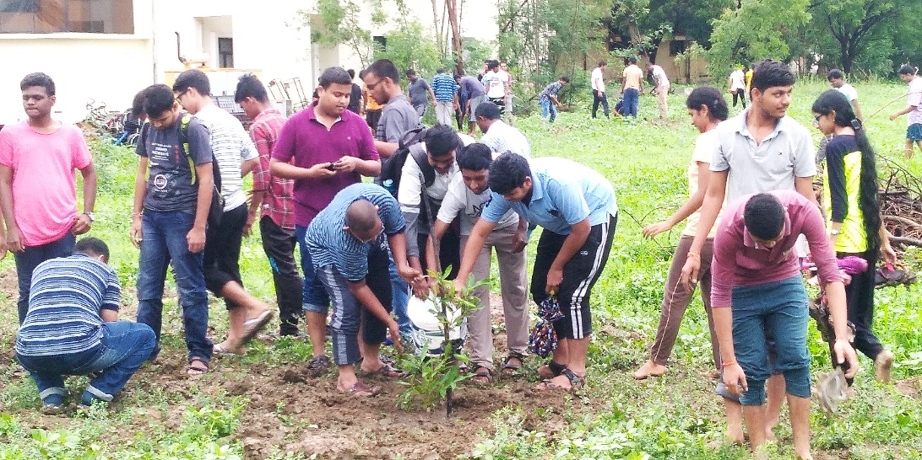
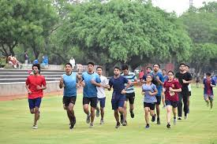
2 Physical Health and Related Activities

Slide 8
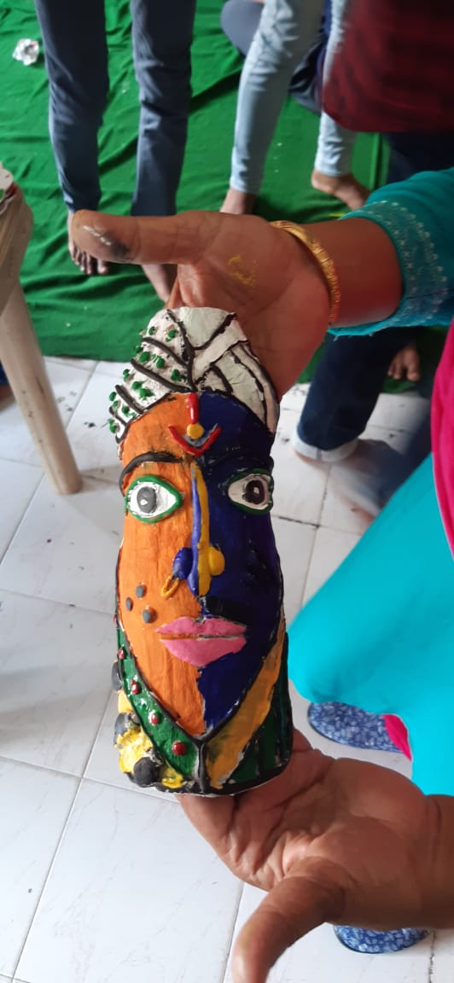
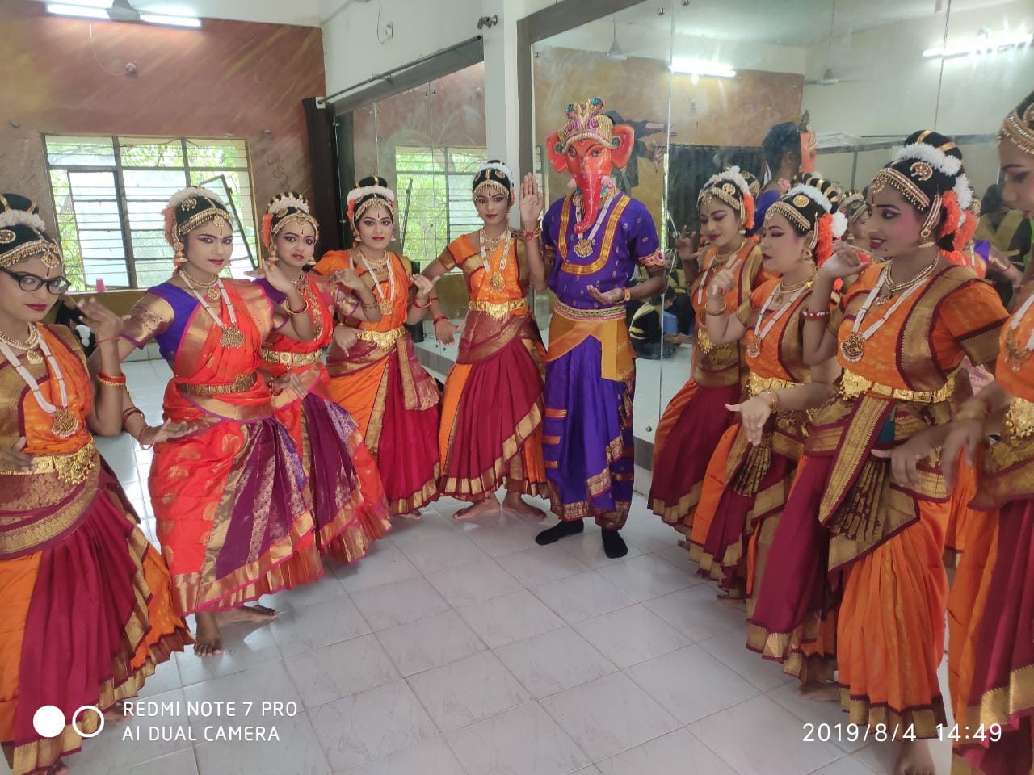
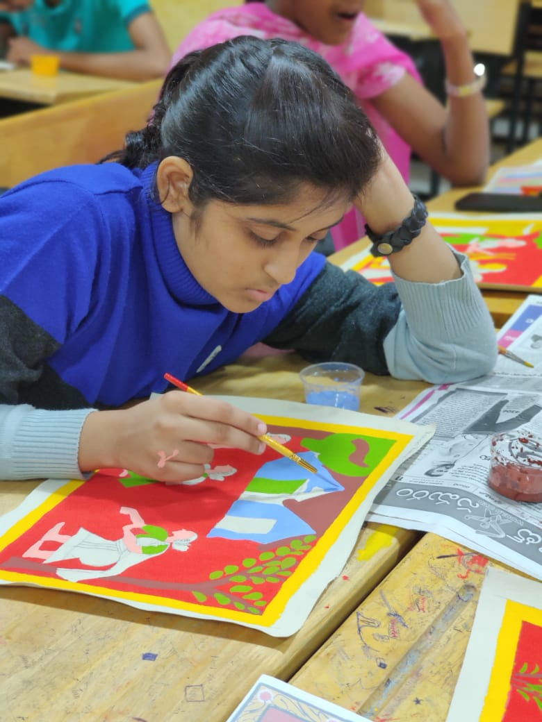
3 Creative Arts and Culture

Slide 9
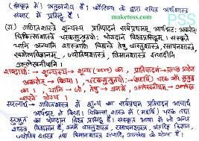
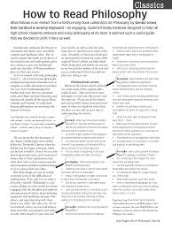
4 Literary Activities

Slide 10
5 Proficiency Modules

Slide 11
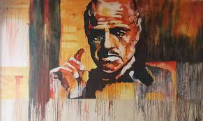
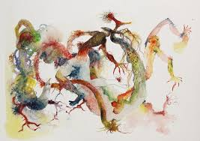
6 Lectures by Eminent People

Slide 12
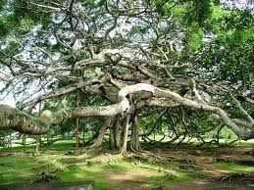
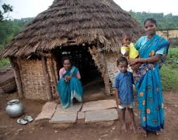
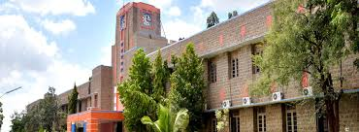
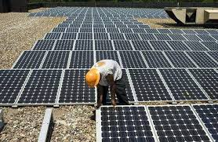
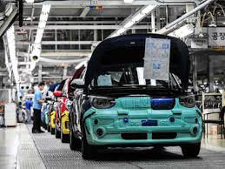
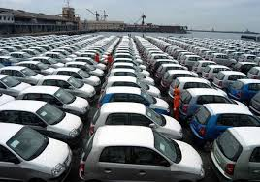
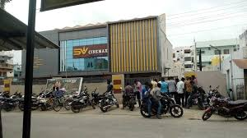
7 Visits to Local Areas

Slide 13
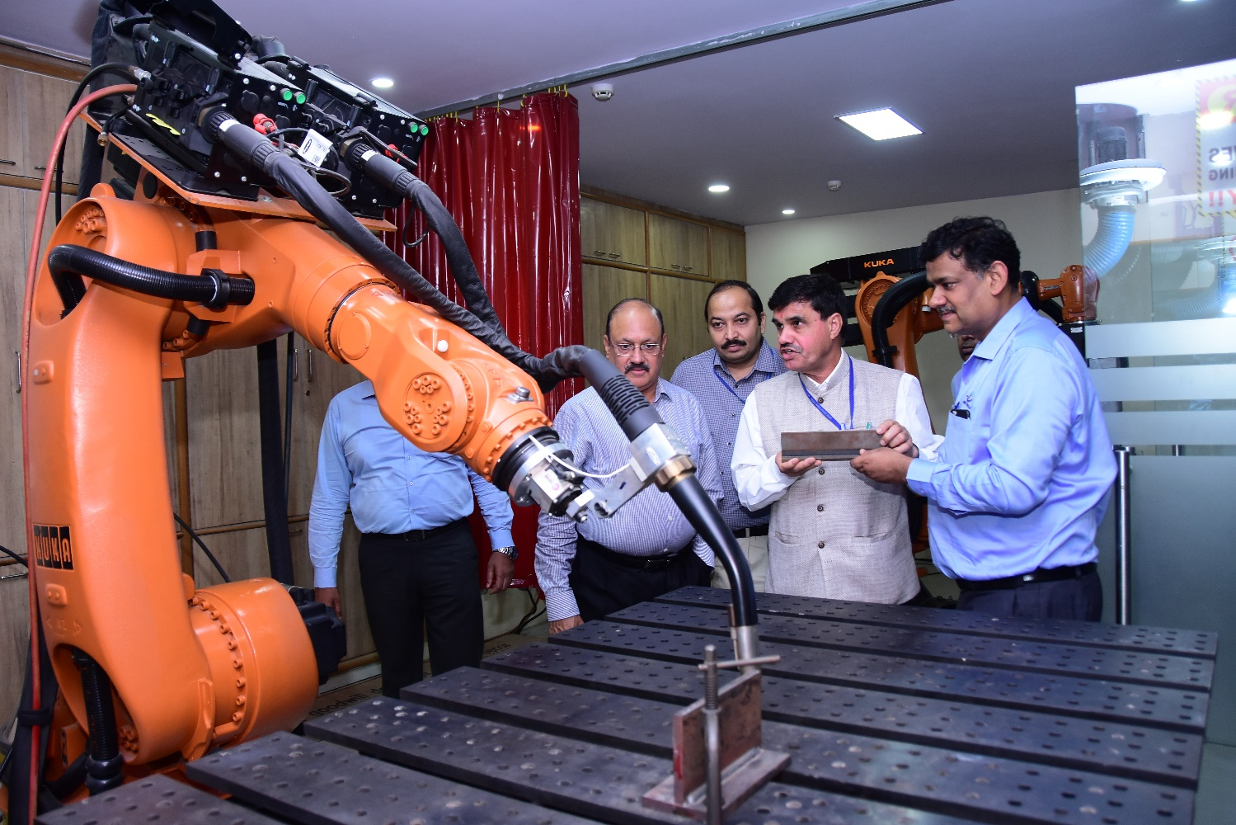
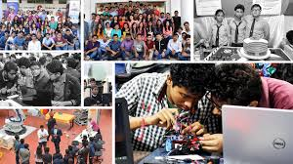
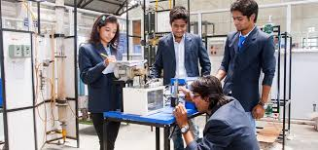
8 Familiarisation to Institution, Department/Branch

Slide 14
Extra-Curricular Activities in College
Shiksha Sopan
NSS
Various Clubs…

Slide 15
Resources for SIP UHV-I Facilitators
AICTE Web Portal for Student Induction Program
http://www.fdp-si.aicte-india.org/
Preparatory FDPs:
3-day FDP-SI
7/8-day FDP-SI
Teaching Material:
SIP Detailed Manual
Mentor’s Manual for UHV-I
Videos
Handouts:
Instructions to Participants (post FDP)

Slide 16
Thank You

